Slide 1
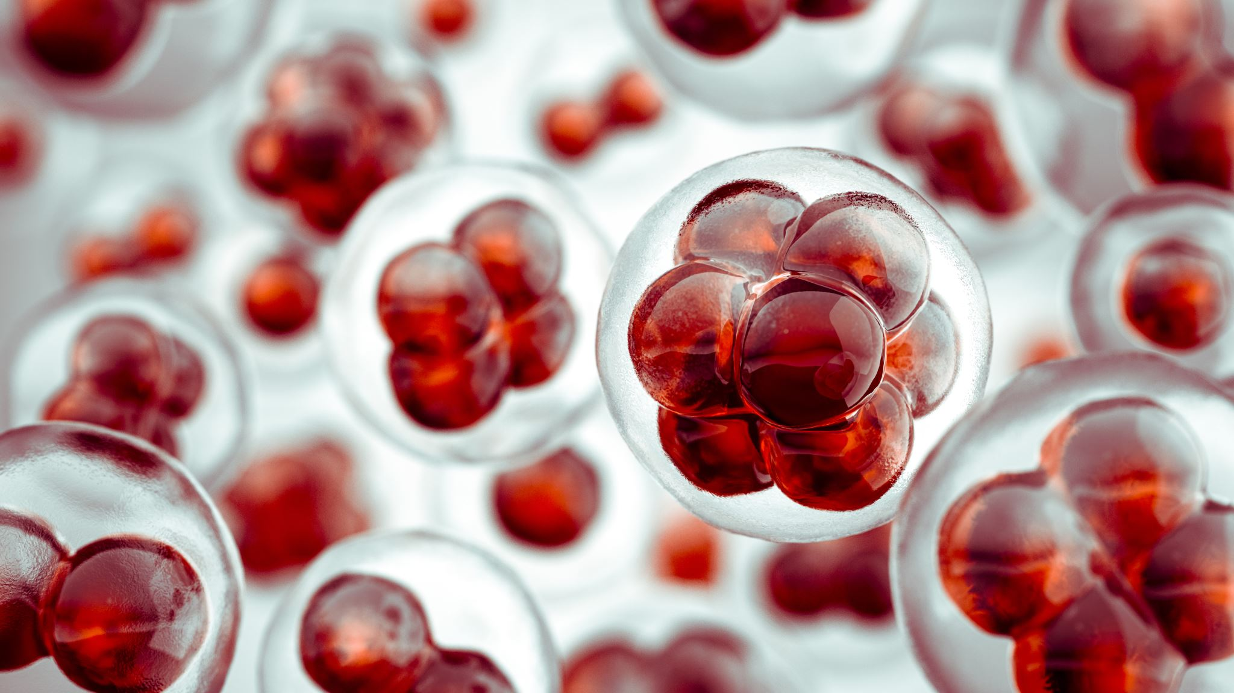
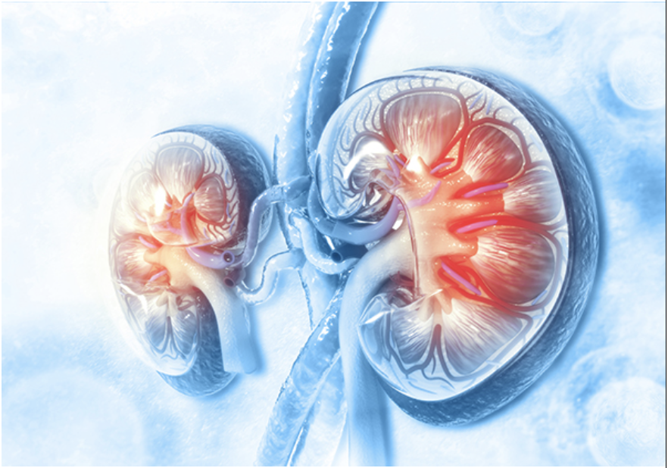
Predictive Intelligence for Chronic Kidney Disease(Predict CHRONIKID)
Turning kidneys into fortune tellers! With Random Forest and Naive Bayes, we predict chronic kidney disease before it strikes—because early detection is the real magic trick!
Coders- Alekhya Koduri
Original coders- https://github.com/Saurabh641444/Chronic-Kidney-Disease-Prediction

